Slide 1

Uniride
School of Computer Science and Engineering
Department of Computer Science and Engineering
Submitted By:
Harshit Attri
23FE10CSE00435
Supervised By:
Dr.Juhi Singh

Slide 2
Outline
Introduction
Literature Review
Problem Statement
Proposed Solution
Objectives
Results

Slide 3
INTRODUCTION
Uniride
The Campus Commute Solution
Uniride is a dedicated web platform designed to bridge the gap between college students and local drivers.
Facilitates ride-sharing specifically for the campus community.
Allows students to find affordable rides quickly.
Empowers drivers to connect directly with passengers without heavy platform fees.

Slide 4



Empowering Commute
Quick & Affordable
Driver Freedom
Campus Community
Allows students to find cost-effective rides instantly. We prioritize affordability to fit the student budget while ensuring you get to class on time.
Empowers drivers to connect directly with passengers. Say goodbye to middlemen—keep more of your earnings without heavy platform fees.
More than just a ride app, Uniride is a dedicated bridge for the campus community, fostering trust between local drivers and students.

Slide 5
LITERATURE REVIEW

Slide 6
Current Market Gaps
Why standard ride-hailing fails students:
Neglected Demographics: Existing ride-hailing giants often overlook the unique scheduling and budget constraints of student populations.
Surge Pricing: Prices often spike specifically during class dismissal hours, making rides unaffordable when they are needed most.
Accessibility Issues: A significant lack of driver availability in campus outskirts and dorm areas leaves students stranded.

Slide 7
The Peer-to-Peer Advantage
Building a safer community:
Community Trust: Research consistently suggests that community-based transport models significantly increase interpersonal trust compared to anonymous services.
Enhanced Verification: By strictly verifying student identities through campus credentials, platforms create a closed-loop safety environment.
Safety First: This verified peer-to-peer structure offers a statistically safer alternative to public, unvetted ride-sharing options.

Slide 8
PROBLEM STATEMENT

Slide 9
The Commuter's Struggle
Students face daily challenges with transportation that impact their time and budget.
High Costs: Unpredictable cab fares drain student allowances.
Haggling: Wasting time negotiating prices with drivers.
Inefficiency: Long wait times and ride cancellations.
Driver Instability: Drivers struggle with platform commissions and lack of control over their earnings.

Slide 10
Objectives
For Students
Minimize daily commute expenses through shared rides.
Reduce time spent waiting for cabs or buses.
Enhance safety by riding with verified peers or trusted drivers.
For Drivers
Provide equal opportunity to independent drivers.
Allow drivers to set competitive fares without platform interference.
Create a steady stream of passengers from the university hub.

Slide 11
Proposed Methodology

Slide 12
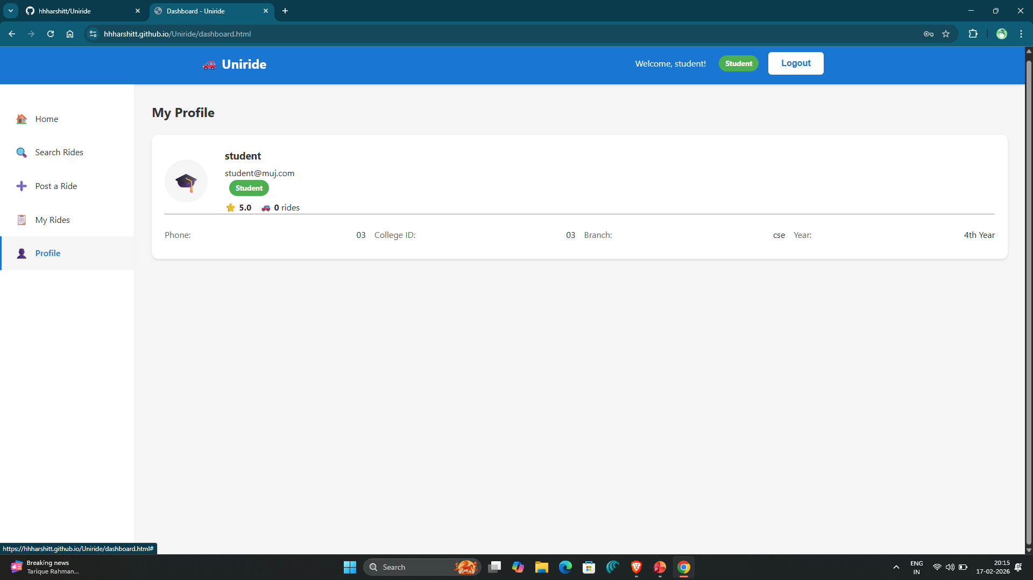
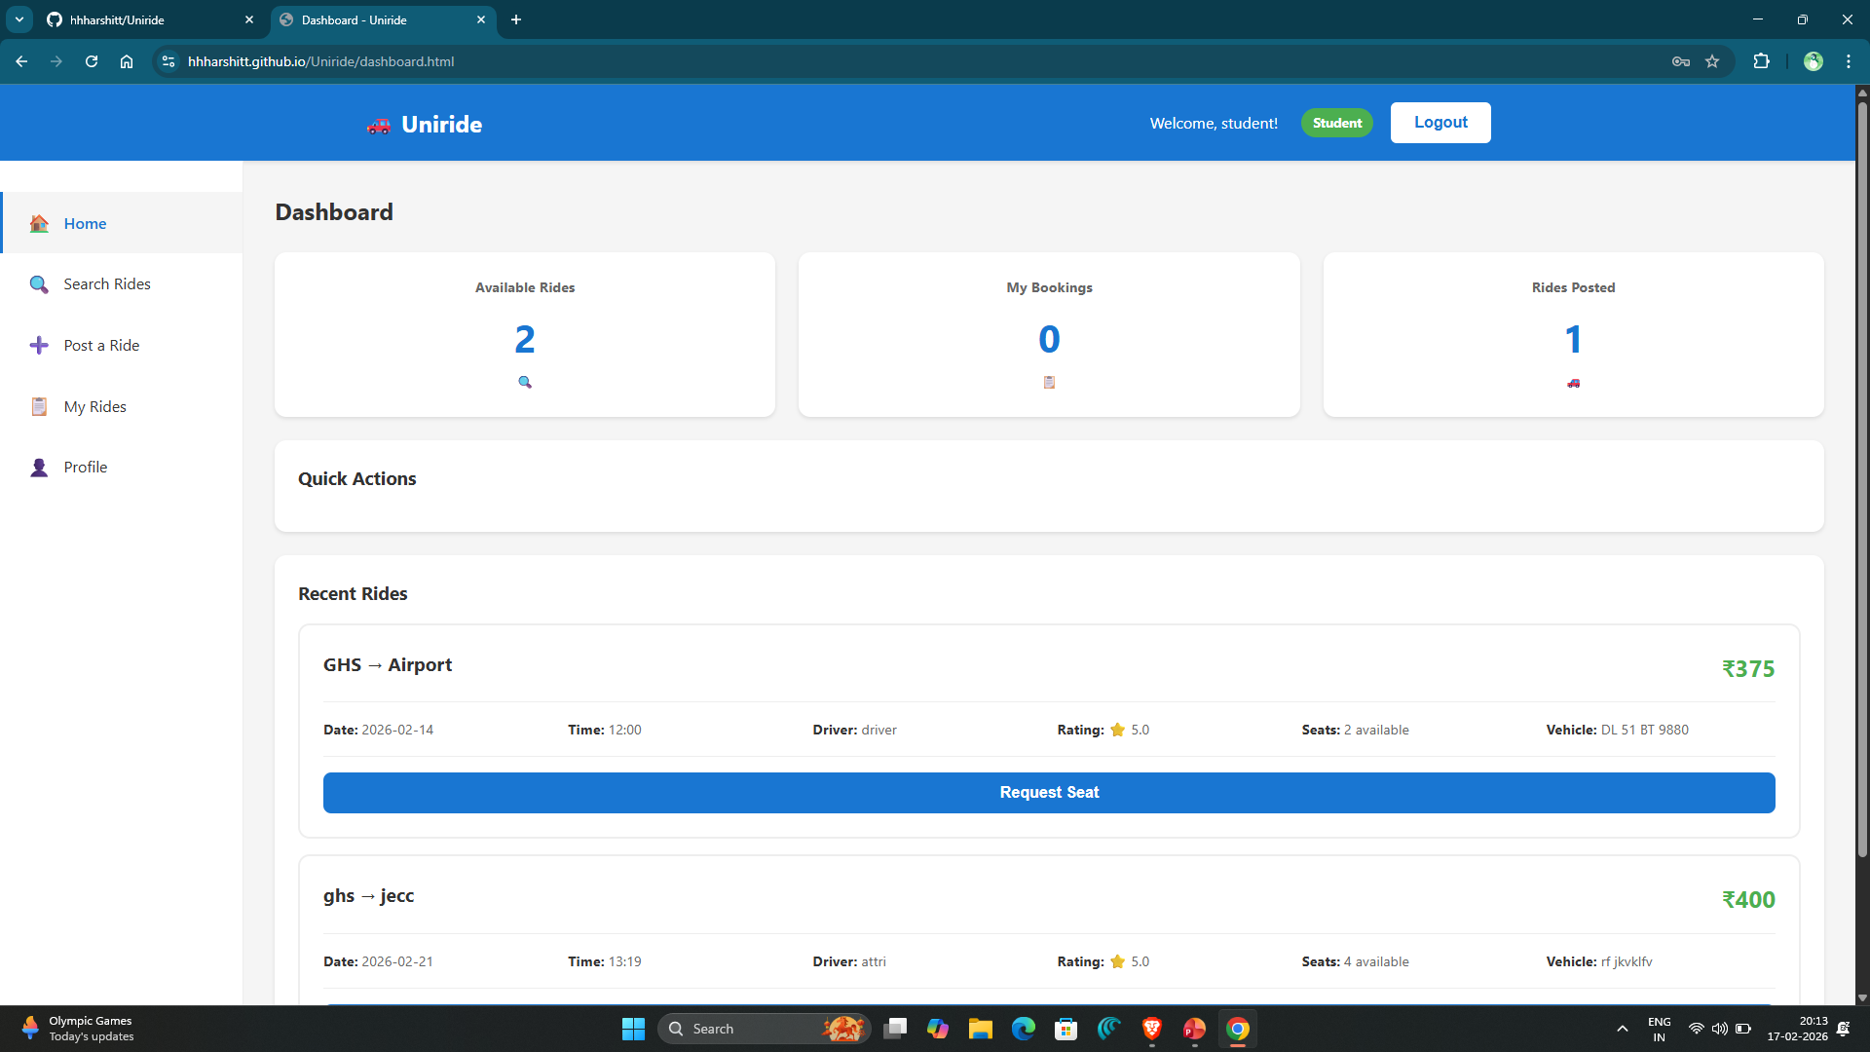
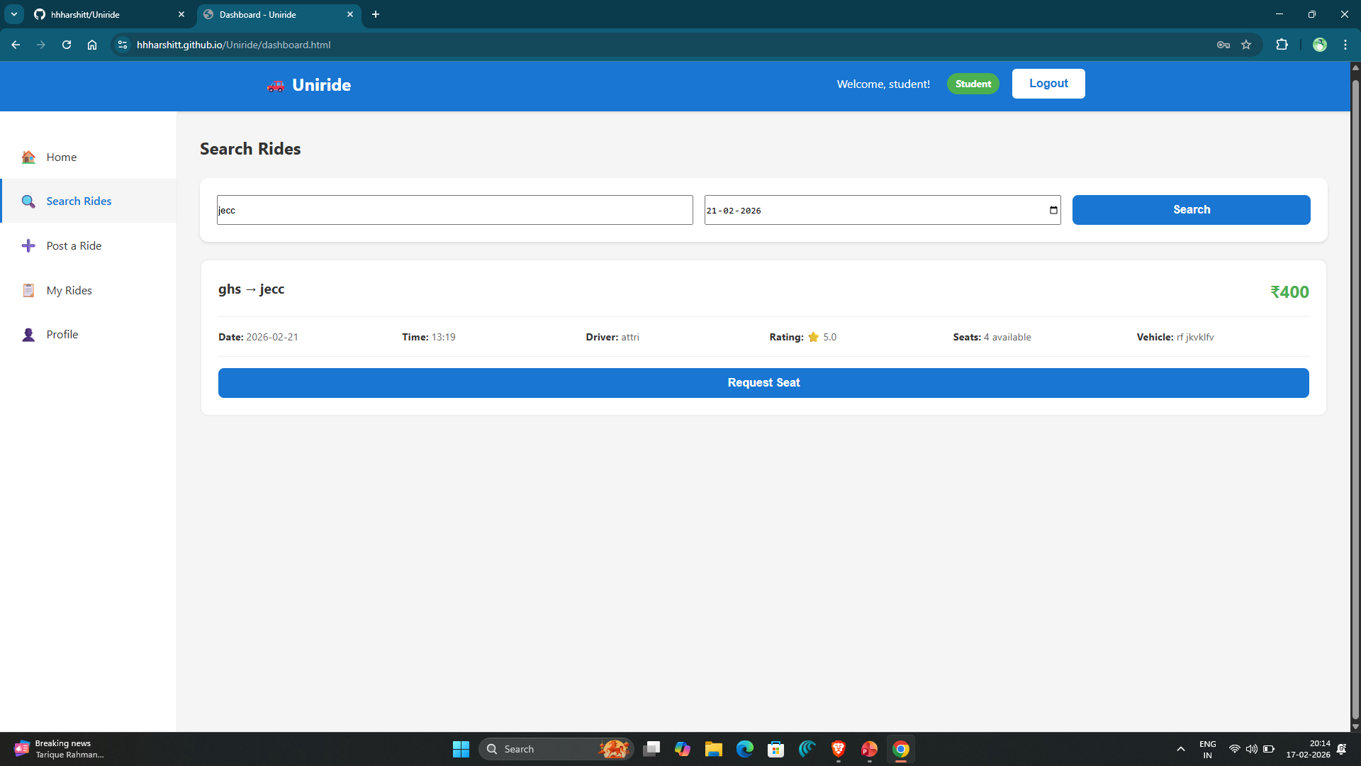
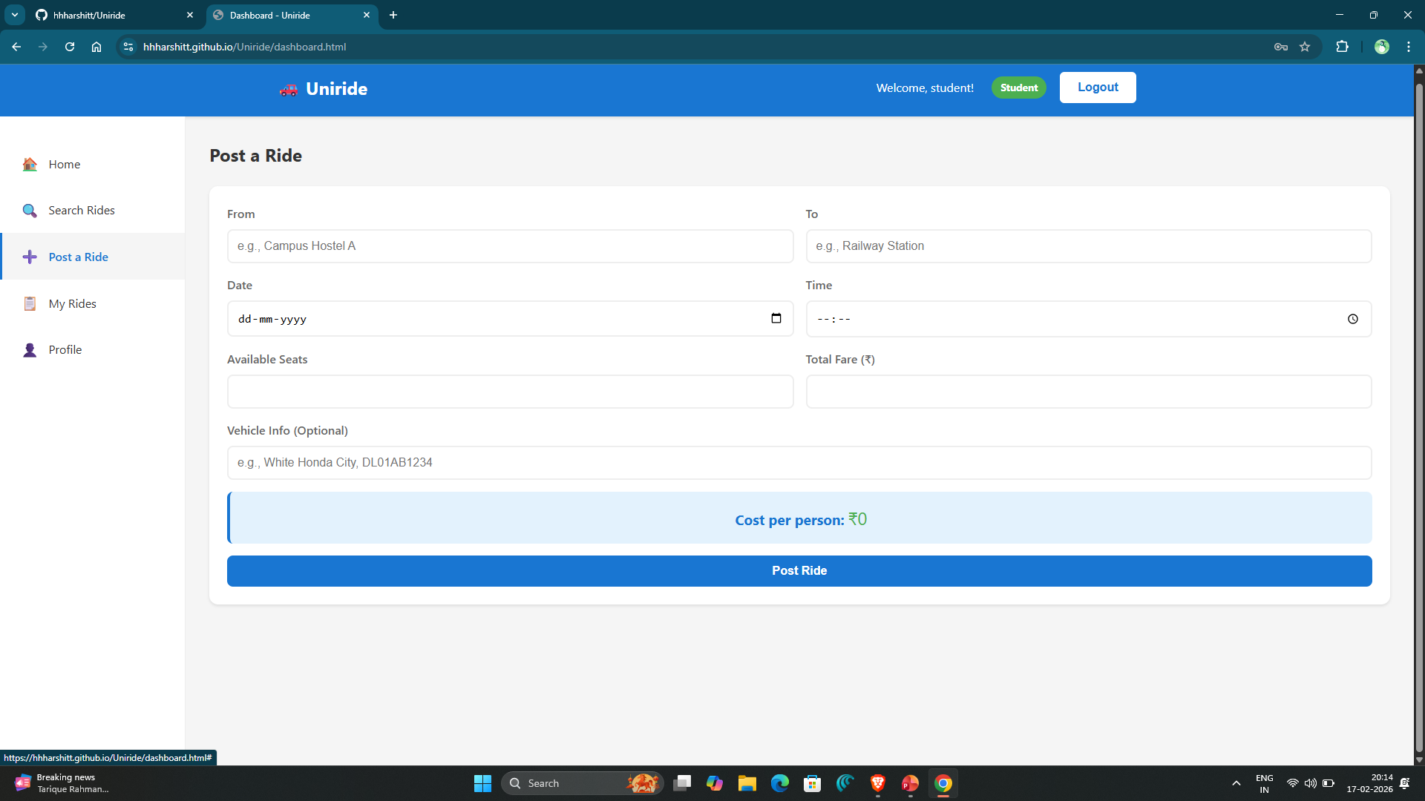
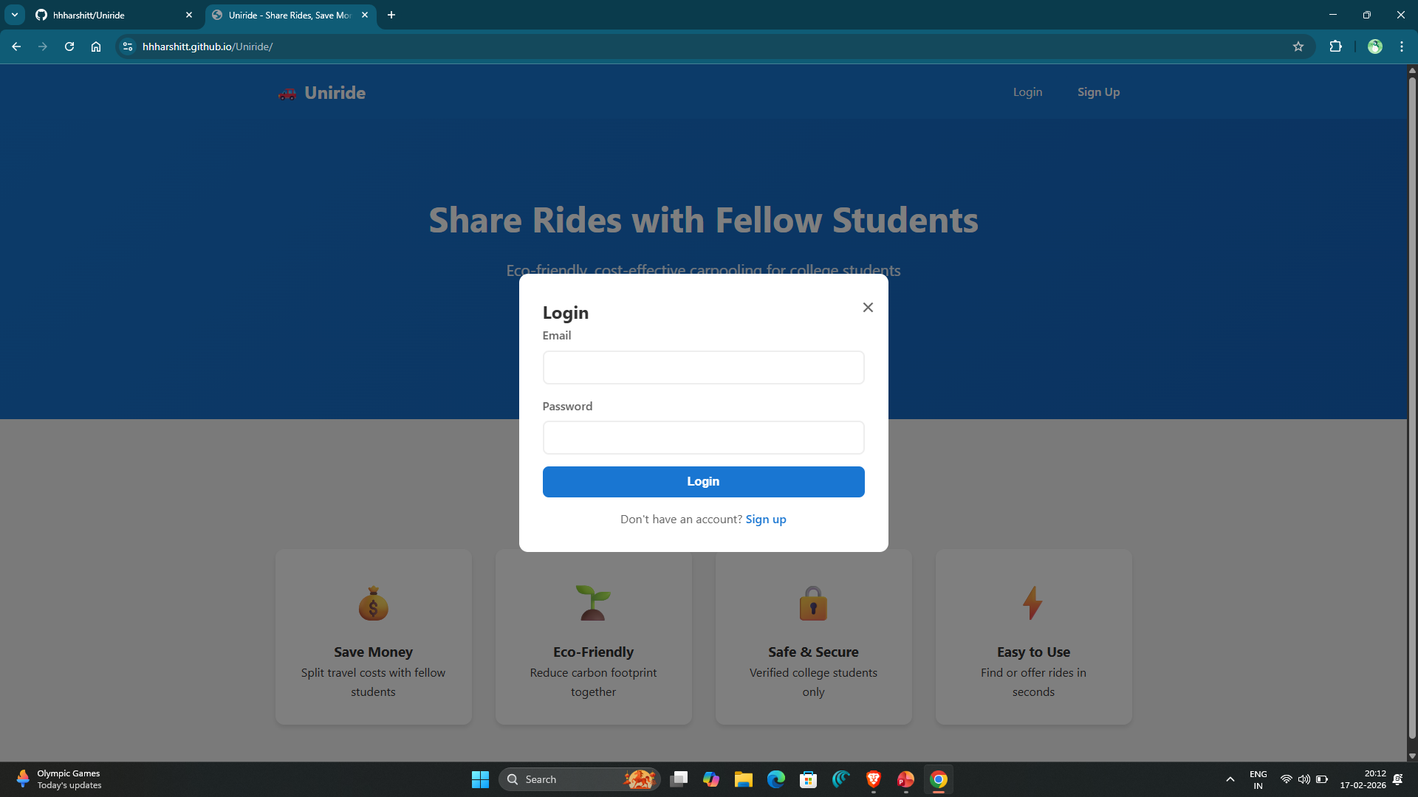
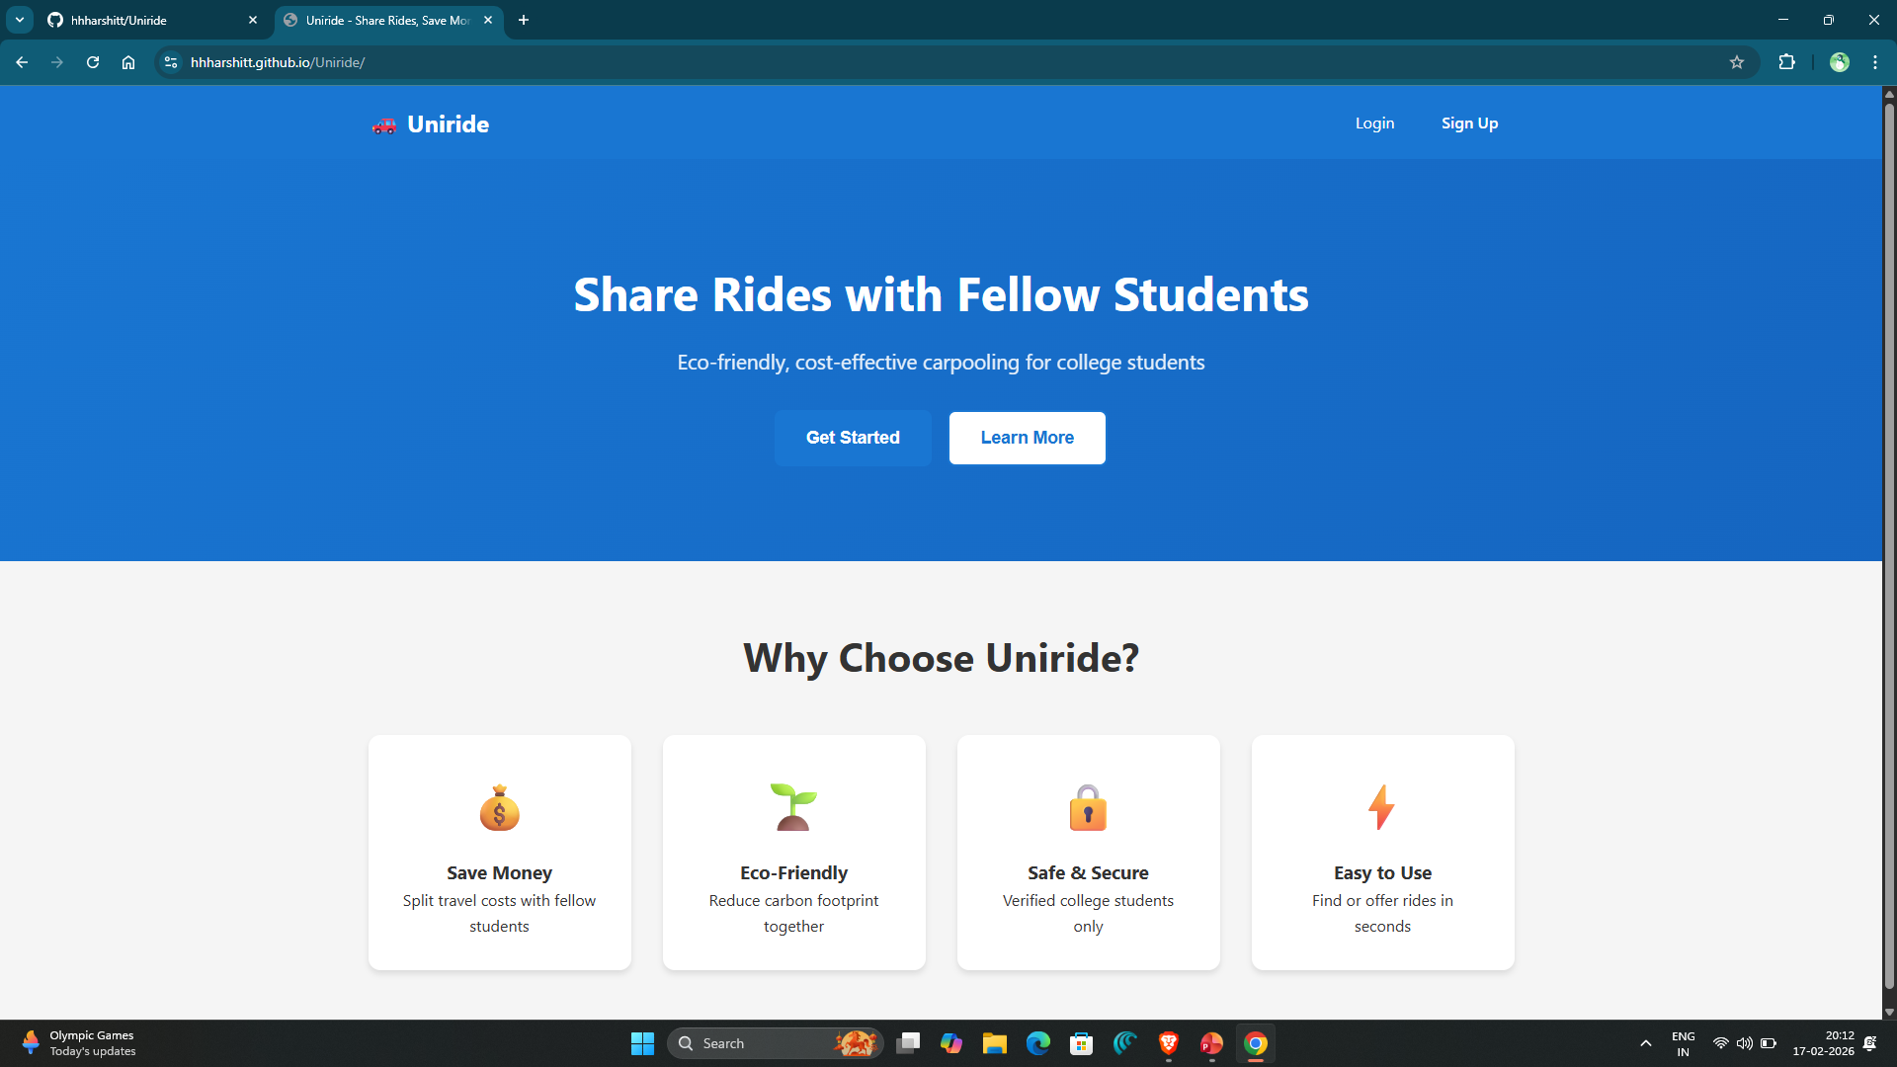
Easy Interface

Slide 13
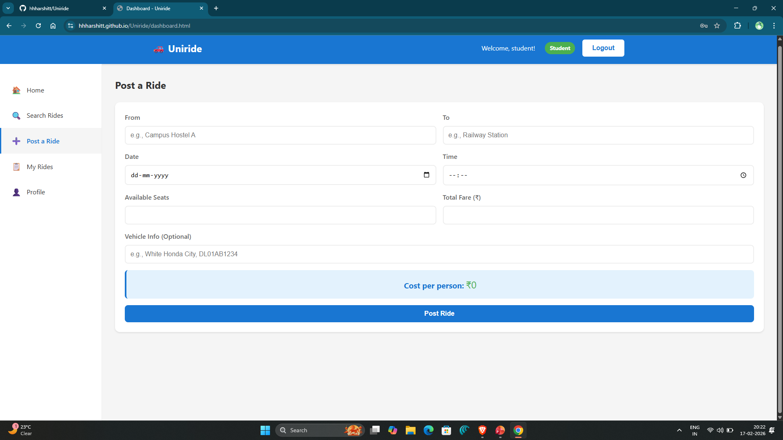
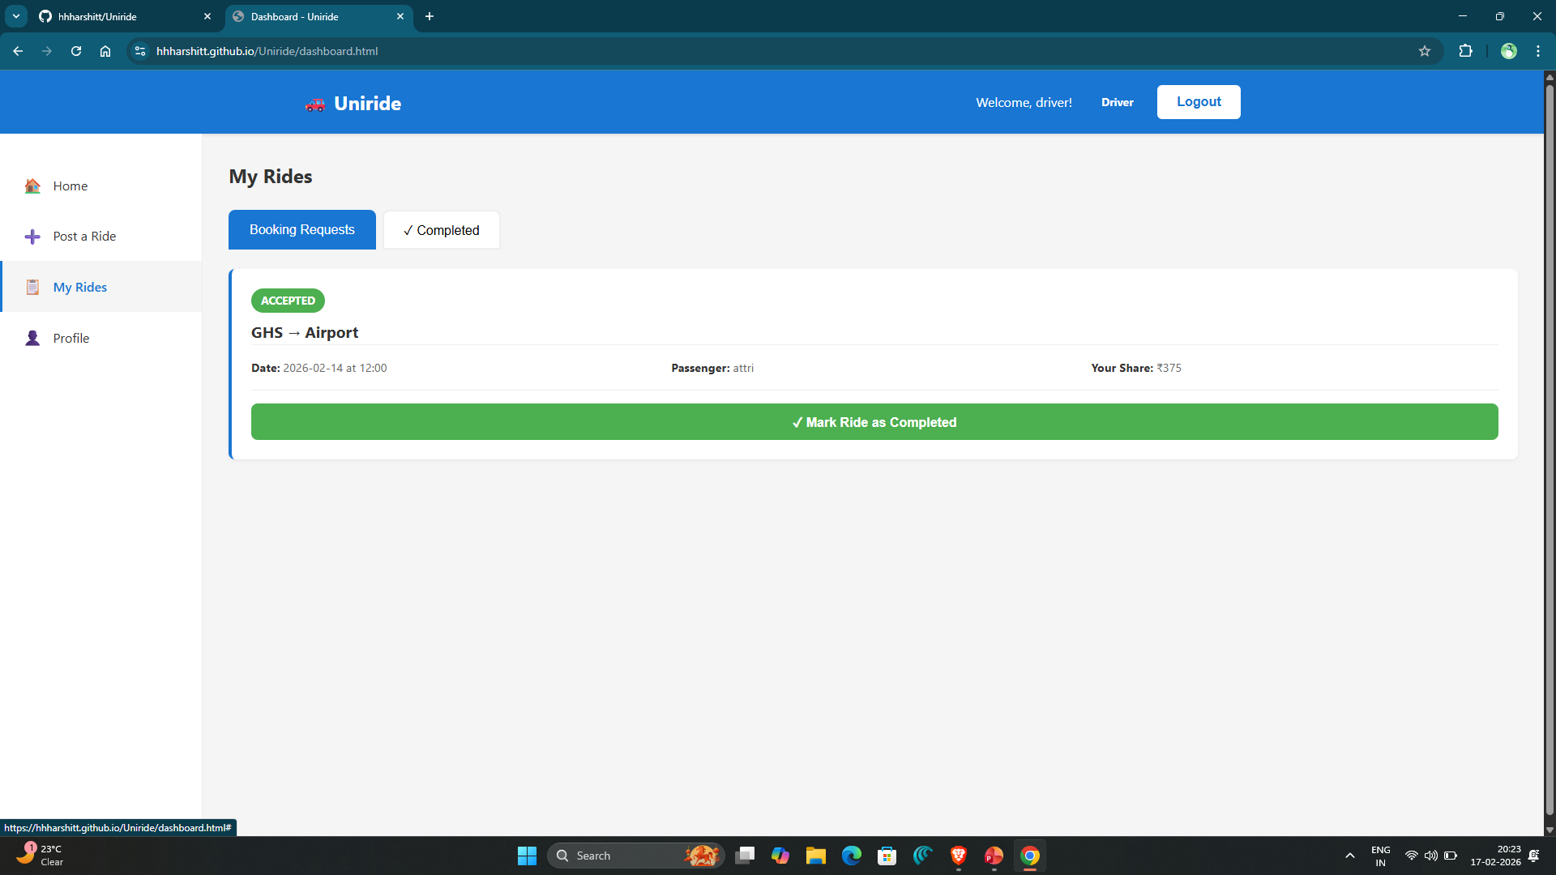
Easy to post rides

Slide 14
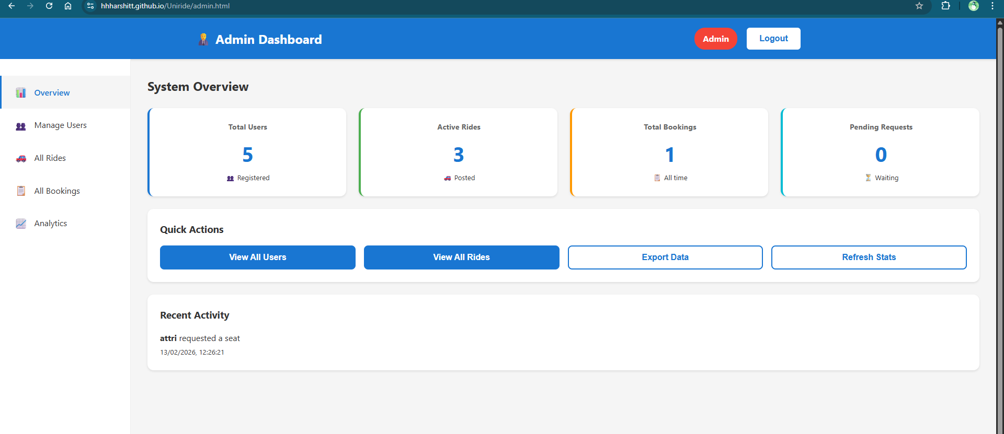
Admin control

Slide 15
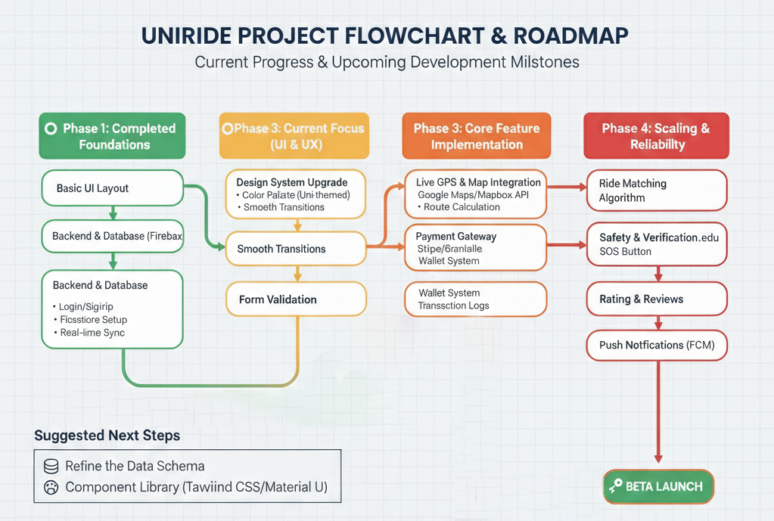
Flowchart and Roadmap

Slide 16
Result
Uniride has successfully evolved into a validated functional prototype, where the core infrastructure including Firebase authentication and real-time database synchronization is 100% operational and stable. While the "App Shell" and modern UI design system are now 60% complete and significantly faster than earlier versions, the project is currently at a critical pivot point, shifting focus toward the "Real-Time Engine" which includes live GPS tracking and payment integration. You have effectively moved from a basic concept to a structured, data-driven application that is ready to handle the complex logic required for a live carpooling environment at MUJ.

Slide 17
Outcome
The outcome of Uniride reflects a transition from a conceptual framework to a live, functional ecosystem tailored for the MUJ community
Project Outcome & Real-Time Deployment (partial deployment)
By the end of the current semester, I have achieved a fully functional prototype with a real-time backend deployed via Firebase and a web interface hosted on GitHub Pages, successfully validating core features like user authentication and live data synchronization. Moving into the next semester, the final outcome will be a partially completed real-time deployment that integrates live GPS tracking and a student-specific matching algorithm, providing a production-ready MVP (Minimum Viable Product) capable of facilitating secure, verifiable carpools between students. This evolution ensures that the project moves beyond a simple interface to a scalable tool that solves the commute problem within the university ecosystem.

Slide 18
References
Google Firebase Documentation: Reference for backend scaling, real-time database synchronization, and user authentication.
Google Maps Platform / Mapbox SDK: Documentation for implementing live GPS tracking and route polyline calculations.
Uber Case Studies: Reference these for ride-matching logic and post-ride rating systems.

Slide 19
Thank You

